Slide 1


CITS1003 Introduction to Cybersecurity [7] Security Management
Dr David Glance

Slide 2
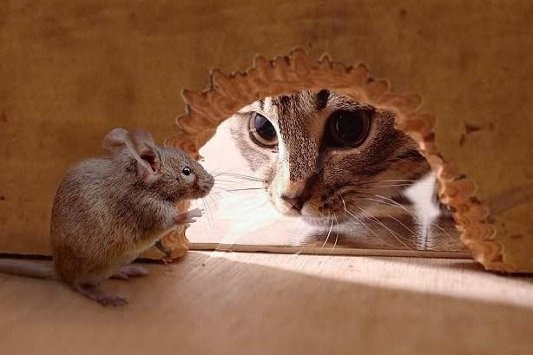
A unit about cats cybersecurity

Slide 3

3 things
Understand the process of risk analysis
Understand the concept of an attack tree
Understand the security management systems and controls that manage the risk process

Slide 4
Security Management
The overall process for managing security risk within an organization
Several standards set out the process including accreditation and certification
ISO/IEC 27001 is a standard that requires that an organization has:
Performed risk analysis to recognize their information assets and their associated information security risks based on threats, vulnerabilities, and impacts
Designed and implement a coherent and comprehensive suite of information security controls and/or other forms of risk treatment to address those risks
Adopted a management process to monitor, review and update risks and controls on an ongoing basis
Other standards that are similar include Australia’s Protective Security Policy Framework (https://www.protectivesecurity.gov.au/) and NIST Cybersecurity Framework (https://www.nist.gov/cyberframework)

Slide 5
Establishing an ISMS
Many organisations implement an 27001-like security management system but unless you are doing it properly, i.e. to get certified
Although information security refers to non-digital assets, very few companies store non-digital information
Even if they use paper, it is archived digitally for example
Security requirements come from 3 sources (ISO/IEC 27002):
Information security risks based on an organization’s business strategy and objectives
Legal, statutory, regulatory and contractual obligations
The principles, objectives and business requirements for information processing that an organization has developed to support its operations.

Slide 6
Security Policy
Outlines an organizational approach to security through a set of policies that cover:
Internal organisation
Information security roles and responsibilities, segregation of duties, contact people
Mobile devices and teleworking
Employment
Screening/onboarding, Information security awareness and training, disciplinary processes, termination
Asset management
Media handling
Access control
User access management
System application access control

Slide 7
Security Policy 2
Cryptographic controls
Physical and environmental security
Operations security
Communications security
Systems acquisition, development and maintenance
Supplier relationships especially supply chain
Incident management
Business continuity

Slide 8
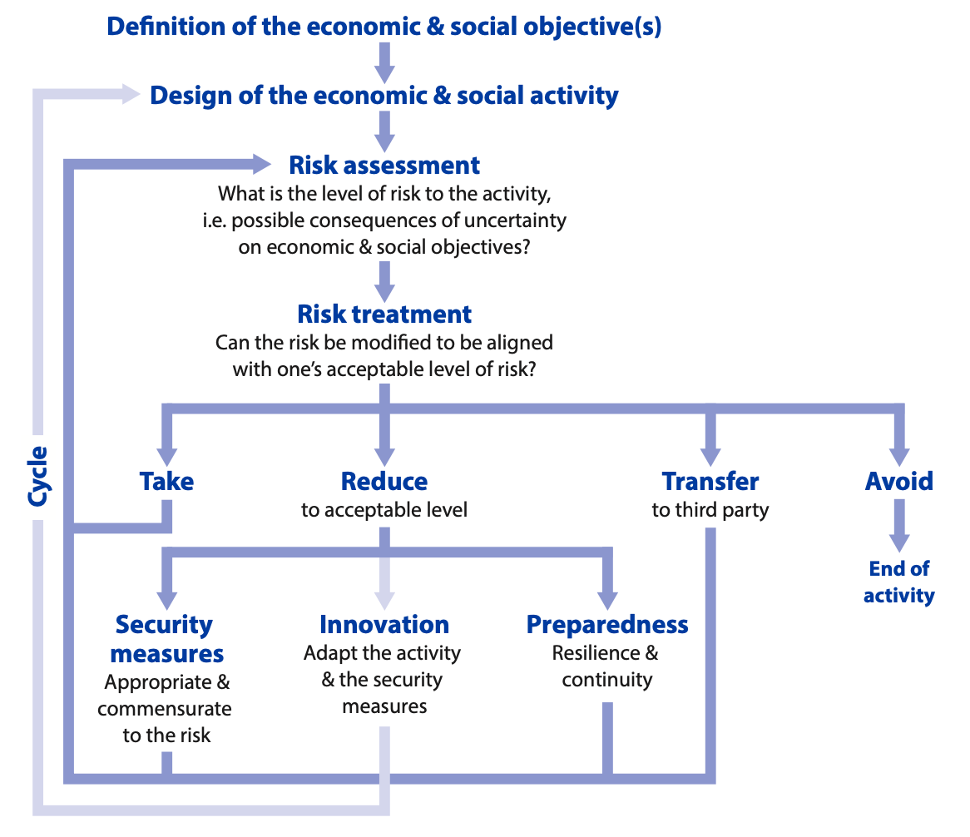
Risk Management
OECD recommendations for Digital Security Risk Management https://www.oecd.org/sti/ieconomy/digital-security-risk-management.htm
Importance of understanding economic and social activities of the business
Risk governance

Slide 9
Assessing Risk
Qualitative
Quantitative
In both cases, need to understand:
The business itself
Assets of organisation
Threat analysis
Vulnerability assessment

Slide 10
Qualitative Risk Assessment
Uses a variety of techniques to assess risk
Brainstorming
Delphi technique: anonymous question and answer technique
Storyboarding
Focus groups
Surveys/Questionnaires
Checklists
Can help in communication of risks but difficult to prioritise based on the range of values

Slide 11
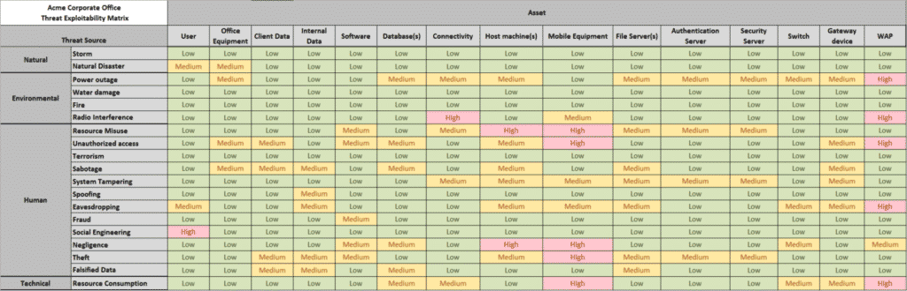
Qualitative Risk Assessment

Slide 12
Quantitative Risk Assessment
Asset Valuation AV
Exposure Factor EF %
Single Loss Expectancy SLE = AV * EF
Annualized Rate of Occurrence ARO %
Annualized Loss Expectancy ALE
Cost/Benefit of countermeasures

Slide 13
Example
You own an iPhone 12 which costs AU $1,349. If you drop the phone and the screen breaks, the cost of repair is AU $850. You have dropped your phone on average once every 2 years
AV = $1,349
Exposure Factor = 0.63
Single Loss Expectancy = $850
Annualized Rate of Occurrence = 0.5
Annualized Loss Expectancy = 0.5 * 850 = $425
Apple Care+ costs $199 for 3 years and $45 per incident for screen replacement
Annualized cost of insurance = $67 + $45 * 0.5 if there is an incident = $92
$425 > $92 and so insurance is worth it

Slide 14
Risk Treatment: Part 1
Once risks have been identified, they can be:
Reduced or mitigated
Use controls to reduce risk
Assigned or transferred
Transfer to a third party such as a cloud provider
Use cyberinsurance
Accepted
Accept the potential losses
Deterred
Try and avoid the risk by using deterences such as policies and warnings, security cameras, guards, fences, auditing etc

Slide 15
Risk Treatment: Part 2
Avoided
Change the business so that the risk is avoided. e.g. choose a different supplier or provider
Rejected or ignored
Don’t accept the risk as being credible (dangerous move)

Slide 16
Residual Risk
Once a risk is treated, the remaining risk is called residual risk
So if total risk = threats * vulnerabilities * asset value
And the risk reduction from treatment is controlled risk
Then residual risk = total risk – controlled risk

Slide 17

Attack Tree

Slide 18
Attack Tree
What is an attack tree?
It is a graphical representation of the different paths that an attacker might take to achieve a specific attack goal.
It is used to identify potential weaknesses within a system and develop strategies to mitigate those weaknesses.

Slide 19
Attack Tree
What is the structure of an attack tree?
root node describes the goal of an attack
child node represents a sub-goal or an attack step for the overall goal
leaf node refers to an attack step and has no child node

Slide 20
Attack Tree
1 disable a web server
1.1 conduct a DDoS attack against the server
1.2 remotely shutdown the server
1.2.1 brute force the server's login credentials to gain an unauthorized access

Slide 21
Attack Tree
What is the structure of an attack tree?
root node is the overall goal of the attack
child node represents a sub-goal or an attack step for the overall goal
leaf node refers to an attack step and has no child node
logical gate denotes the relationship among different nodes
OR gates: completing only one child node can lead to the completion of a parent node
AND gates:

Slide 22
Attack Tree
1 steal valuable items from a jewelry store
1.1 smash the display case and grab items
1.2 force a store employee to open the display case

Slide 23
Attack Tree
What is the structure of an attack tree?
root node is the overall goal of the attack
child node represents a sub-goal or an attack step for the overall goal
leaf node refers to an attack step and has no child node
logical gate denotes the relationship among different nodes
OR gates: completing only one child node can lead to the completion of a parent node
AND gates: completing all child nodes so that a parent node can succeed

Slide 24
Attack Tree
1 gain an unauthorized access to a secure building
1.1 obtain a valid access card
1.2 steal the door passcode

Slide 25
Example
1. gain an access to a target user’s private information
1.1 gain an access to a target user database
1.1.1 exploit a software vulnerability in the system
1.2 log in as a target user
1.2.1 brute-force login
1.2.1.1 search a target username
1.2.1.2 search a target user password
1.2.2 steal user private credentials
1.3 hijack user session
1.3.1 steal user session cookie
OR

Slide 26
1 gain an access to a user’s private information
1.1 gain direct access to the database
1.2 Login as target user
1.3 Hijack user session

Slide 27
Exercise
1. gain an access to a target user’s private information
1.1 gain an access to a target user database
1.1.1 exploit a software vulnerability in the system
1.2 log in as a target user
1.2.1 brute-force login
1.2.1.1 identify a target username
1.2.1.2 identify a target user password
1.2.2 steal user private credentials
1.3 hijack user session
1.3.1 steal user session cookie
OR

Slide 28
1 gain an access to a user’s private information
1.1 gain direct access to the database
1.2 Login as target user
1.3 Hijack user session
1.1.1 exploit a software vulnerability in the system
1.2.1 brute-force login
1.2.2 steal user private credentials
1.3.1 Steal user session cookie

Slide 29
Exercise
1. gain an access to a target user’s private information
1.1 gain an access to a target user database
1.1.1 exploit a software vulnerability in the system
1.2 log in as a target user
1.2.1 brute-force login
1.2.1.1 identify a target username
1.2.1.2 identify a target user password
1.2.2 steal user private credentials
1.3 hijack user session
1.3.1 steal user session cookie
AND

Slide 30
1 gain an access to a user’s private information
1.1 gain direct access to the database
1.2 Login as target user
1.3 Hijack user session
1.1.1 exploit a software vulnerability in the system
1.2.1 brute-force login
1.2.2 steal user private credentials
1.3.1 Steal user session cookie
1.2.1.1 identify a target username
1.2.1.2 identify a target user password

Slide 31
root node
1 gain an access to a user’s private information
1.1 gain direct access to the database
1.2 Login as target user
1.3 Hijack user session
1.1.1 exploit a software vulnerability in the system
1.2.1 brute-force login
1.2.2 steal user private credentials
1.3.1 Steal user session cookie
1.2.1.1 identify a target username
1.2.1.2 identify a target user password

Slide 32
root node
1 gain an access to a user’s private information
1.1 gain direct access to the database
1.2 Login as target user
1.3 Hijack user session
1.1.1 exploit a software vulnerability in the system
1.2.1 brute-force login
1.2.2 steal user private credentials
1.3.1 Steal user session cookie
1.2.1.1 identify a target username
1.2.1.2 identify a target user password
leaf node
leaf node

Slide 33
Controls
Controls are applied to mitigate cybersecurity risk
Types:
Physical
Technical
Administrative
Functions
Preventative
Detective
Corrective

Slide 34
Technical Controls
Technical, or logical, controls are the use of hardware or software to manage access provide protection to assets
Examples include:
Authentication methods
Encryption
Anti-malware software
IDPS
Firewalls

Slide 35
Administrative Controls
Organisation’s policies and procedures defined by its security policies
Focus on personnel and business practices
Examples include:
Hiring practices
Security screening
Data classification and labelling
Security awareness training

Slide 36
Physical Controls
Physical controls that prevent, monitor or detect unauthorised access to assets
Examples include
Lock systems
CCTV
Swipe cards
Mantraps
Alarms

Slide 37
Deterrent Controls
Discourages violation of security policies through visible warnings and consequences for violators
Examples include ﻿security-awareness training, locks, fences, security badges, guards, mantraps, and security cameras.

Slide 38
Preventive Controls
A control that aims to stop violation of security policies. Whilst similar to deterrence, preventive controls are far harder to casually violate than deterrence.
Examples include ﻿locks, biometrics, alarm systems, separation of duties, data classification, penetration testing, access-control methods, encryption, auditing, security policies, security-awareness training, anti-malware software, firewalls, and IPS

Slide 39
Detective Controls
Detective controls are concerned with detecting or discovering malicious activity during or after it has occurred
Examples include audit trails, logging, IDS, honeypots (and honeynets), CCTV

Slide 40
Control Examples
 |  | Control Functions
 |  | Preventative | Detective | Corrective
Control Types | Physical | Fences, gates, locks | CCTV and surveillance camera logs | Repair physical damage, re-issue access cards
 | Technical | Firewall, IPS, MFA, AV | IDS, Honeypots | Patching, Reboot systems, Quarantine malware
 | Administrative | Hiring and Firing practices, Separation of Duties, Data Classification | Review access rights, audit logs, review unauthorised changes | Implement Business Continuity Plan, Incident response plan

Slide 41
Security Operations : Part 1
Need-to-know and Least Privilege
Aim is to keep secrets secret
Grant users and systems access only to data and resources they need for their specific duties
Separation of duties and responsibilities
Never put a single person in charge of an entire function
Includes putting cybersecurity responsibilities outside of IT
Don’t want the people implementing systems also checking them
Two-person control, Job rotation, mandatory vacations,
Privileged account management
Change management

Slide 42
Security Operations: Part 2
Personnel security
Security awareness training
Mobile device management
Working from home
Information management lifecycle
Creation, storage, use, archiving, destruction and purging
Hardware and software
Asset management
Protection of physical assets
Machine rooms: access, cooling and fire prevention
Virtual assets
Licensing and Software License Agreements

